Slide 1

SDP ‘21 - Comprehensive Design Review - Active Windows
Team 6
Jonathan Clifford, Frank Cremonini, Griffin Manns, Connor Moore
Advisor: Professor Arman Pouraghily
Manhattan2 CTO & Contact: Mr. Glenn Weinreb
Notes:
Jonathan

Slide 2
Overview
Problem Statement
Introduction
System Specifications
Our System & Block Diagrams
CDR Deliverables
Current Prototype & Demonstration
Project Management
FPR Plan
Notes:
Jonathan

Slide 3
Problem Statement
“With climate change becoming ever more relevant, engineers from every discipline are scrambling to combat the issue. Through methods such as green energy technologies and reducing reliance on fossil fuels, our society has made significant progress. However, there is still much work to be done. The average home presents opportunities for countless improvements in energy conservation. In particular, heating and cooling of homes present the opportunity for many inefficiencies to be addressed, including the lack of automation of residential climate control. For instance, to account for temperature variances, an individual may choose to run power-hungry central air systems as opposed to using manually adjusted power-saving alternatives. However, a sufficiently smart home automation system could replace human negligence and laziness and utilize alternative energy saving options that take advantage of the existing features of homes.”
Notes:
Jonathan
With climate change becoming ever more relevant, engineers from every discipline are scrambling to combat the issue. Through methods such as green energy technologies and reducing reliance on fossil fuels, our society has made significant progress. However, there is still much work to be done. The average home presents opportunities for countless improvements in energy conservation. In particular, heating and cooling of homes present the opportunity for many inefficiencies to be addressed, including the lack of automation of residential climate control. For instance, to account for temperature variances, an individual may choose to run power-hungry central air systems as opposed to using manually adjusted power-saving alternatives. However, a sufficiently smart home automation system could replace human negligence and laziness and utilize alternative energy saving options that take advantage of the existing features of homes.

Slide 4
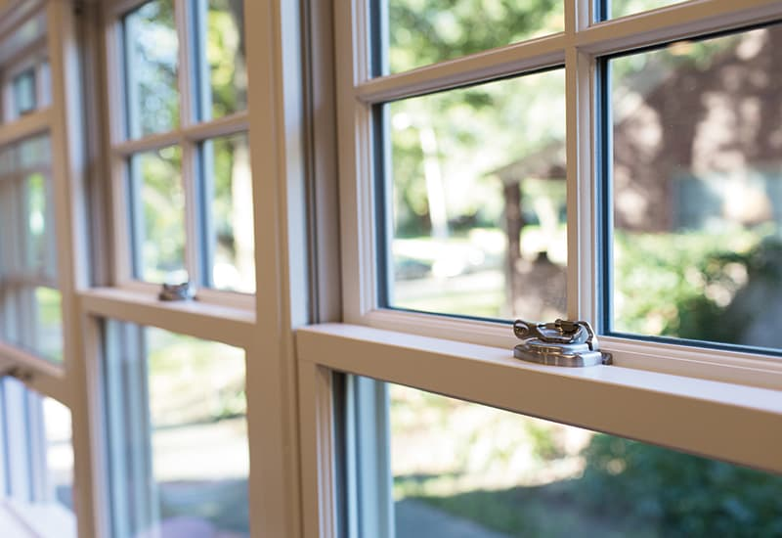
Project Overview
Window Operation
We are focused on contributing to window automation in order to try and combat climate change.
To do so, our team is focused on developing the end to end communications that this proposed system will utilize to communicate internally and externally.
This is done via CAN internally and Amazon Web Services (AWS) externally, both to forward system status as well as User commands to control and monitor the window.
https://www.pellabranch.com/webres/Image/misc/2018-window-glass-option-header.jpg
Notes:
Jonathan
So we are focusing on the window component of this home automation initiative
now talk about where we fall in with the window as a components of this total home automation
on this component we are focusing on the communication underlying system

Slide 5

Our Solution
Windows are “Dumb”, we will attempt to make them more “Active” by allowing automated remote operation of the window.
To achieve this we have the following components:
Android App for the user to interface with the system and operate the window.
Cloud Connection → Monitor and Control from anywhere.
If Cloud is down, locally we have:
A manual override switch.
Direct connection between the Android App & the system.
Network Master Controller to control the local network and interface with Cloud services
Motor Module to operate window.
https://backtest-rookies.com/2018/10/26/tradingview-opening-a-window/
Notes:
Jonathan
Since windows are “dumb” we will attempt to make them more “active”, and consequently smarter, by allowing for remote operation of the window.
In this system a phone application will allow for the user to interface with the system and operate the window.
In order to be able to control the window from anywhere, we can make use of the Cloud in order to facilitate communication.
By using the Cloud, we can ensure that future Engineers can add additional features such as Machine Learning algorithms to adjust the home automatically.
In the event that you cannot connect to the Cloud, we allow for the user to bypass the Cloud by two methods:
A manual override switch that opens the window.
A local connection between the phone and the window that still allows for you to adjust it.
In order to interface with the Cloud, we also need a Network Master Controller to provide the interface between the interior network and exterior cloud infrastructure, as well as a Motor Module to actually perform the requested user commands.

Slide 6
System Specifications
The Active Window Subsystems consisting of the Network Master Controller, IoT/Phone Application, and the Motor Module will meet or exceed the following specifications:
Capable of receiving signals from Amazon Web Services (AWS) for direct communication between the user and the rest of the system.
Capable of transmitting commands from the Android Application through AWS to the Network Master Controller that drives a stepper motor driver, which in turn adjusts a window.
User interaction via an Android Phone Application that transmits data via AWS to the controllers. This Application will include a user interface to control and monitor window status.
The Motor Module’s size is at least 14cm x 8cm in order to maximize installation in a home.
DC Stepper Motor and Driver, will utilize a 24V power supply and use a pulley system solution that can adjust the window via commands. This pulley system will physically lower and raise the test window once it receives the proper command.
In addition, there will also be a manual override switch for the test window that is capable of bypassing the Android Application and will raise or lower the window when it is flipped.
In the event of external network failure, the Android Application is capable of sending commands to the Network Master Controller if they are on the same network.
Notes:
Jonathan
These haven’t changed since MDR, but very quickly:

Slide 7
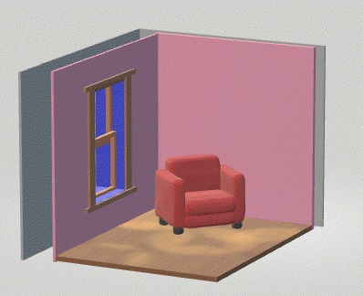
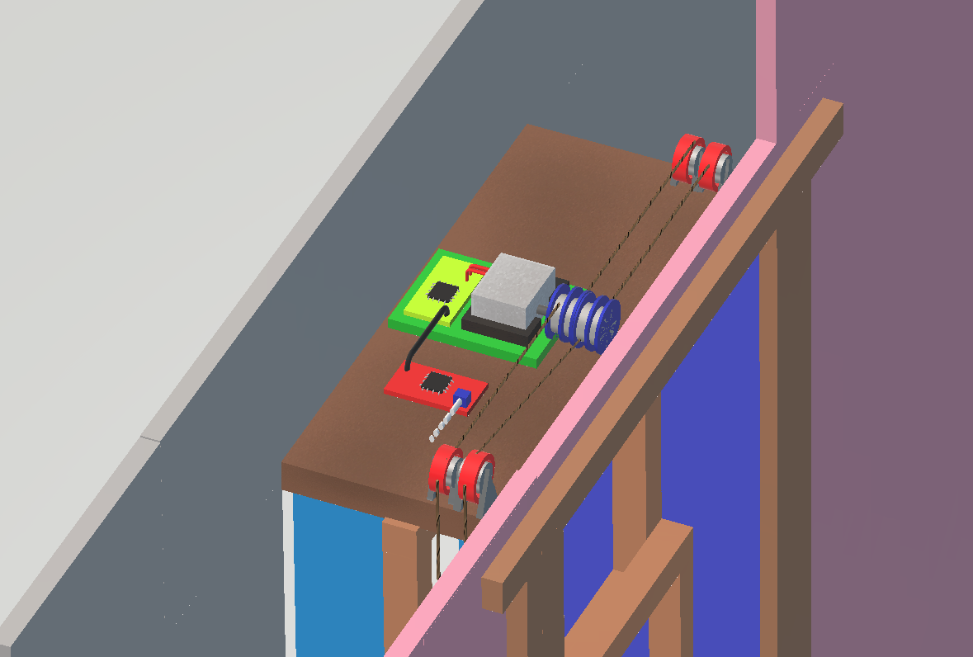
Our Solution in The Field
Notes:
Connor
So before we get into specifics to get a better idea of what these components will look like, here is a mockup of the Physical system
On the left there is an example of our system installed in a home with all the components located within the wall and a seamless installation to appear as a regular window
And on the right is a zoomed in picture of the system located on the top of the window
And on the next slide well have pictures of the model we made
Remake model to updates to design

Slide 8
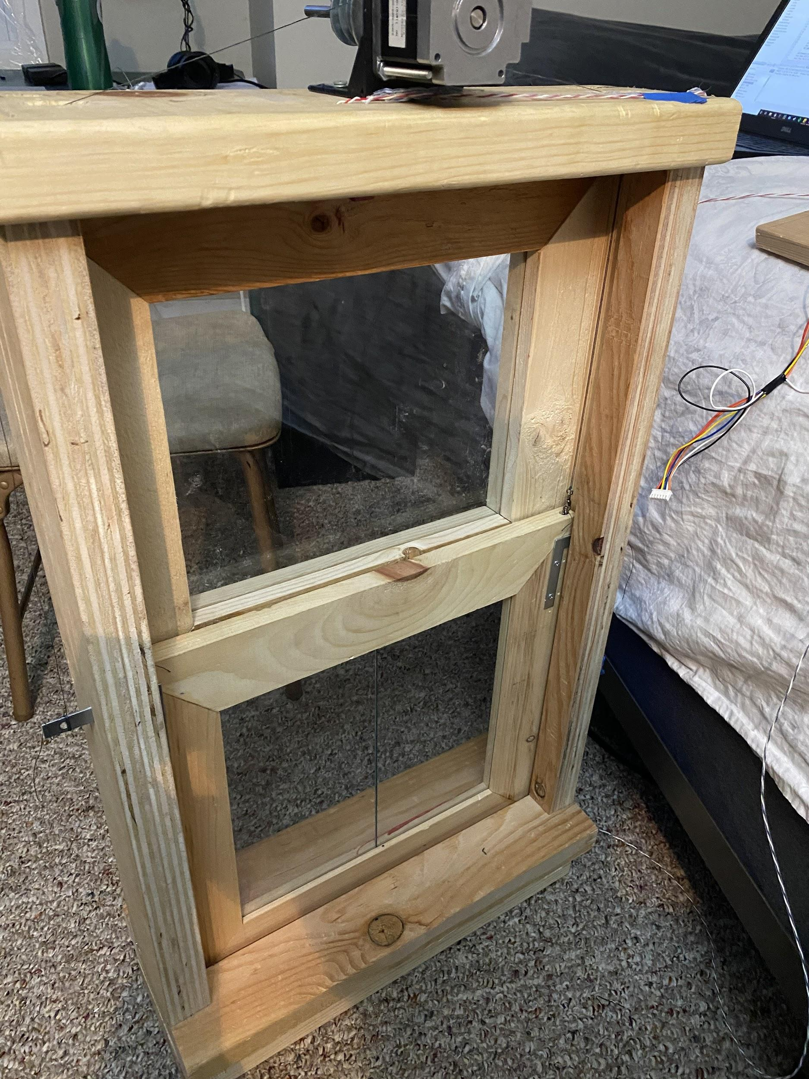
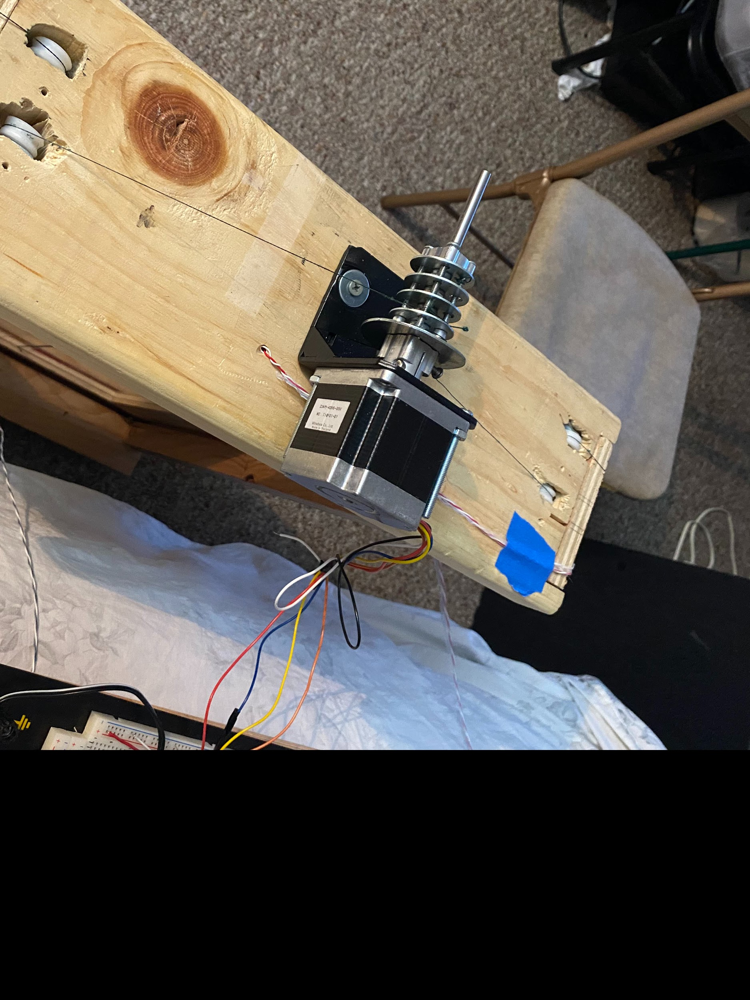
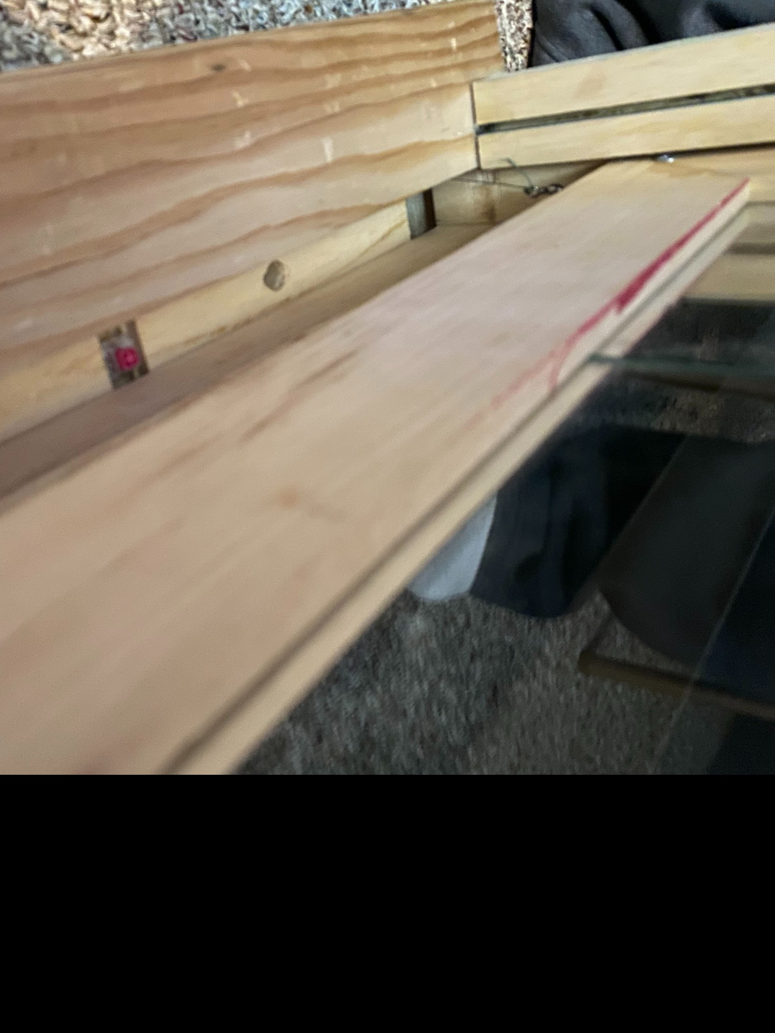
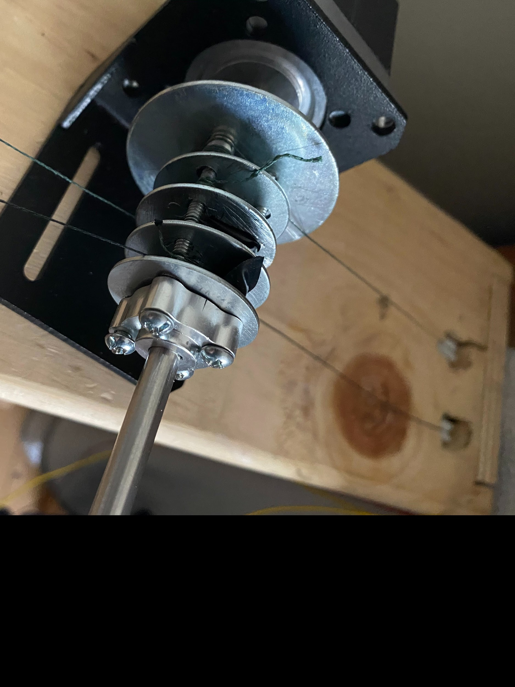
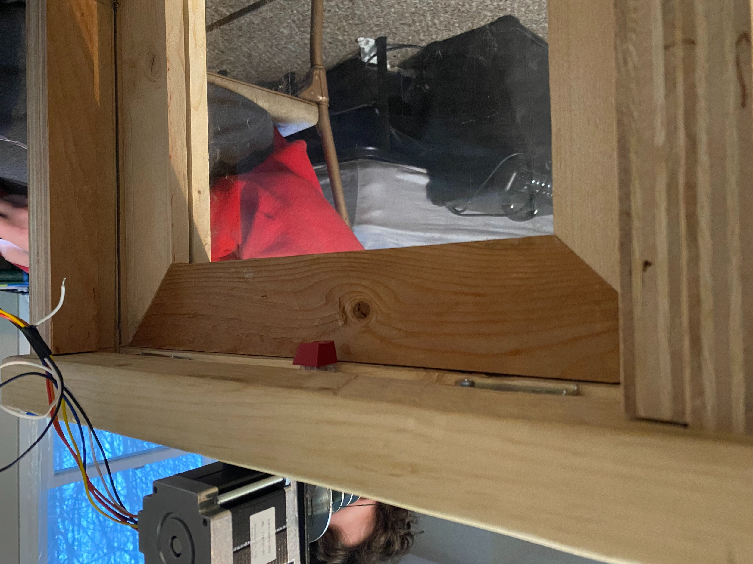
Model Window:
18”
31”
7”
Notes:
Connor
So here we have the model window we made
The dimensions of the window are 18” wide 31” tall and 7” deep.
The depth of the window I decided to use was based off the window in my room which is about 7” from the screen to the outside lip. The height and width of window were all based off the two pieces of plexiglass that I had In my garage and just built the frame off of that.
For hardware
there are 4 pulleys, with one set of string attached to the top of the window and the other set attached to the bottom of the window.
The second set of pulleys was to add downward force to the window aside from just gravity pulling it down.
The two pictures on the far right are the limit switches that we will explain later.
The motor which is placed on the top of the window fits just within the dimensions of the window and for FPR I plan to cut the remaining axe so its not extending outside of the window frame
While here we have the motor module on a breakout board for FPR we plan to work the PCB into the structure of the window.

Slide 9
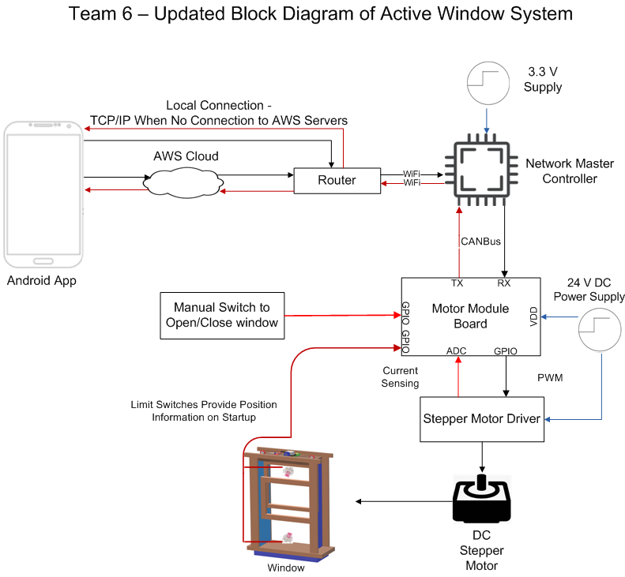
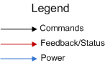
Updated Hardware Block Diagram
Notes:
Connor
-So starting from left to right we have the Android app that is used to monitor and send commands to the system
through AWS
AWS cloud is used to forward these commands
in the event of a lost of connection direct connection to the NMC through the router is also possible
-Then on the right we have the xmc4800 that is able to connect and receive the commands through an internet connection via router and ethernet
-Continuing down there is the MotorModule which is an XMC4200 and communicates via CAN with the NetworkMasterController
-Connected to this via GPIO we have a localized switch used to operate the window manually, limit switches located on the top and bottom of the window used for a homing algorithm. Then finally the motor driver with is used to drive the motor.

Slide 10
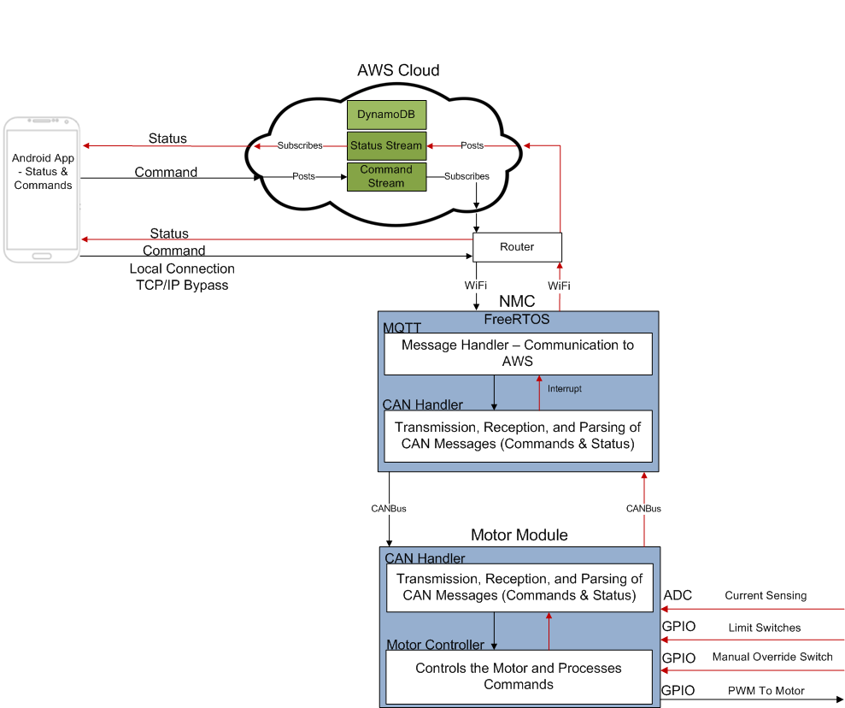
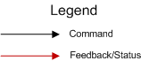
Updated Software Block Diagram
Notes:
Connor
So again starting at the App on the left, it can communicate with AWS cloud via Wifi
and as mentioned before can also directly connect
Moving on to the AWS cloud
inside this we take advantage of a Publish&Subscribe message stream
Publishers send messages
Subscribers get messages
On the NMC we are running a open Source version of FreeRTOS which is a real time operating system
inside of this system there are two main components
AWS Message Handler, which is used to receive and transmit messages to AWS
below that we have a software component for handling transmission and reception of CAN messaging from the motor Module
And finally on the Motor Module
There is a similar software component the handle CAN messages
As well as a component used to operate the Stepper Motor

Slide 11
CDR Deliverables
Full end to end communication.
Send a command via the Android phone application
AWS receives this command and forwards it to the NMC
NMC receives the command, sent to Motor Module using CANBus
Motor Module acutates based on command, sends status to NMC
NMC Forwards to AWS, displayed in Android Application
Local Connection
NMC and Android Application communicate over local (same) network
Manual Override Switch
Local switch to adjust window
Notes:
Frank
In essence, the entire system is capable of full end to end communication.
A user is able to send a command via the Android phone application. Amazon Web Services (AWS) receives this command and forwards it to the Network Master Controller (NMC). The NMC receives the command, interprets its meeting, and via CANBus communication, forwards this command to the Motor Module. The Motor Module interprets this command and actuates a motor accordingly. When the motor module then completes its task, it sends an acknowledgement back to the NMC, which in turn forwards this back to AWS. The status is then sent to the Android phone application, which displays the status for the user to see.
In addition, in the event that a connection cannot be established between AWS, the Network Master Controller and the Android phone application can communicate between each other with a local connection if they are on the same network.

Slide 12
CDR Demo - Documentation
System fully works and is integrated
Local connection working between two Android Phones
User boots up Android Phone Application
Boot up the AWS Protocol Task.
NMC Responds with an acknowledgement.
Send a command to open the window to a specified percentage, in intervals of 10% (0% - 100%)
Manual override switch to adjust the window manually, in intervals of 10% (0% - 100%)
Notes:
Frank

Slide 13
CDR Demo
Notes:
Jonathan

Slide 14
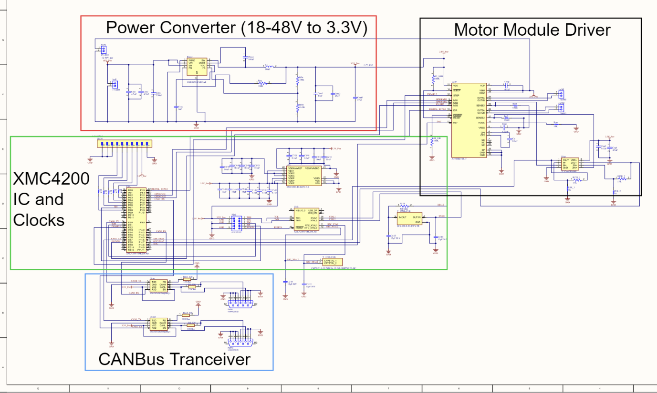
PCB Status & Overview
Notes:
Griff
Schematic:
Now for our teams PCB schematic design created on Altium Designer
Our schematic is broken down into four different parts that wire together to create a PCB board with the functionalities needed of an XMC4200 microcontroller, as well as an A4988 Stepper motor driver.
The part of the schematic shown within the green outline, is the XMC4200’s integrated circuit chip and two Crystal oscillators, that act as clocks for the chip.
XMC4200 IC:
The XMC4200 IC chip is the main part of the PCB, that provides the needed functionalities to connect each of the other parts together through its CAN, GPIO, power, and other valuable pinouts.
Within this part of the PCB there also is a pin header connected to the GPIO pins on the XMC4200 chip, in order to provide input/output communication for the sensing buttons, which track the exact location of the window, as well as the manual override switch
Crystal Oscillators
The two Crystal oscillators provide the clock signals that are needed for synchronization of the internal operations on the board, such as governing the speed at which the processor executes instructions and other necessary functions for the board
The part of the schematic shown within the blue outline, is the CANBus Transceivers
These transceivers connect to the CAN communication pinouts on the XMC4200 IC, which allows for the XMC4200 and PCB to receive and interpret commands from the Network Master controller via CANBus communication
The part of the schematic shown within the black is the A4988 Motor Driver integrated circuit chip, which has the same functionalities as the A4988 Driver we purchased on our breakout board
This Driver IC connects to the GPIO, input/output pinouts, as well as the Post Width Modulation (PWM) pinouts on the XMC4200 IC, in order to receive the interpreted commands sent through the CANBus transceivers.
This Stepper Motor Driver Module then drives the Stepper motor connected to the PCB to follow these commands, which moves the window to the desired location.
The part of the schematic shown within the red outline is the Power Converter, which allows the PCB to take in up to 56 Volts of power via a power supply, and can convert that supplied power down to 3.3 Volts.
This power converter is initially supplied with a 24 Volt power supply in our project, and the 24 Volt power line then connects to the A4988 Motor Driver IC in order to power the 24 Volt Stepper Motor
At the same time the power converter, converts this 24 V power line down to exactly 3.3 volts, in order to power pretty much the rest of the PCB, including the 3 other sub parts mentioned: XMC4200 IC, the A4988 Driver IC, and the CANBus Transceivers

Slide 15
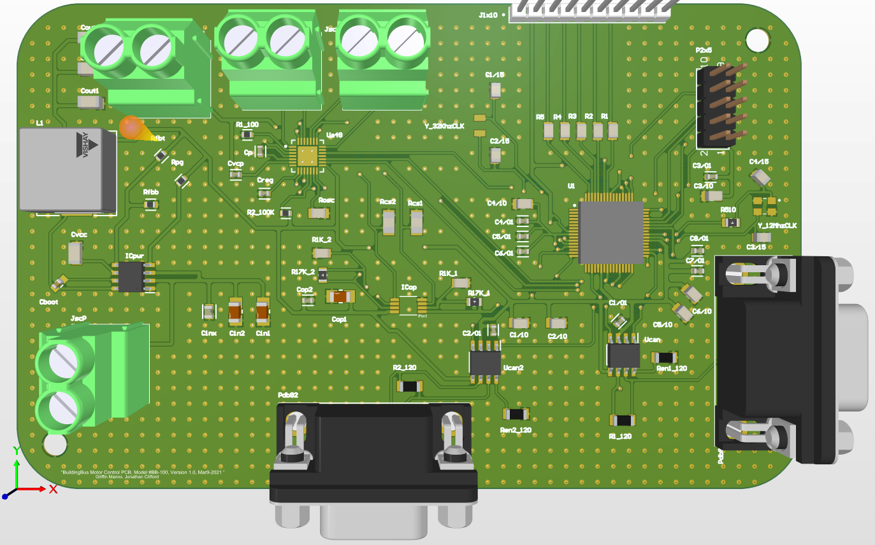
PCB Status & Overview
Notes:
Griff
3D PCB Design:
Once the schematic was finalized, I then imported the design over to the PCB board layout tool on Altium, where I organized the part positions and routed the connections between parts.
The finalized board design is a two-layer Board that is about 13 cm by 8 cm, and will fit easily above our window design
We have the blank PCB physically in hand as well as a Stencil that will make soldering the parts in their exact positions on the PCB easy.

Slide 16
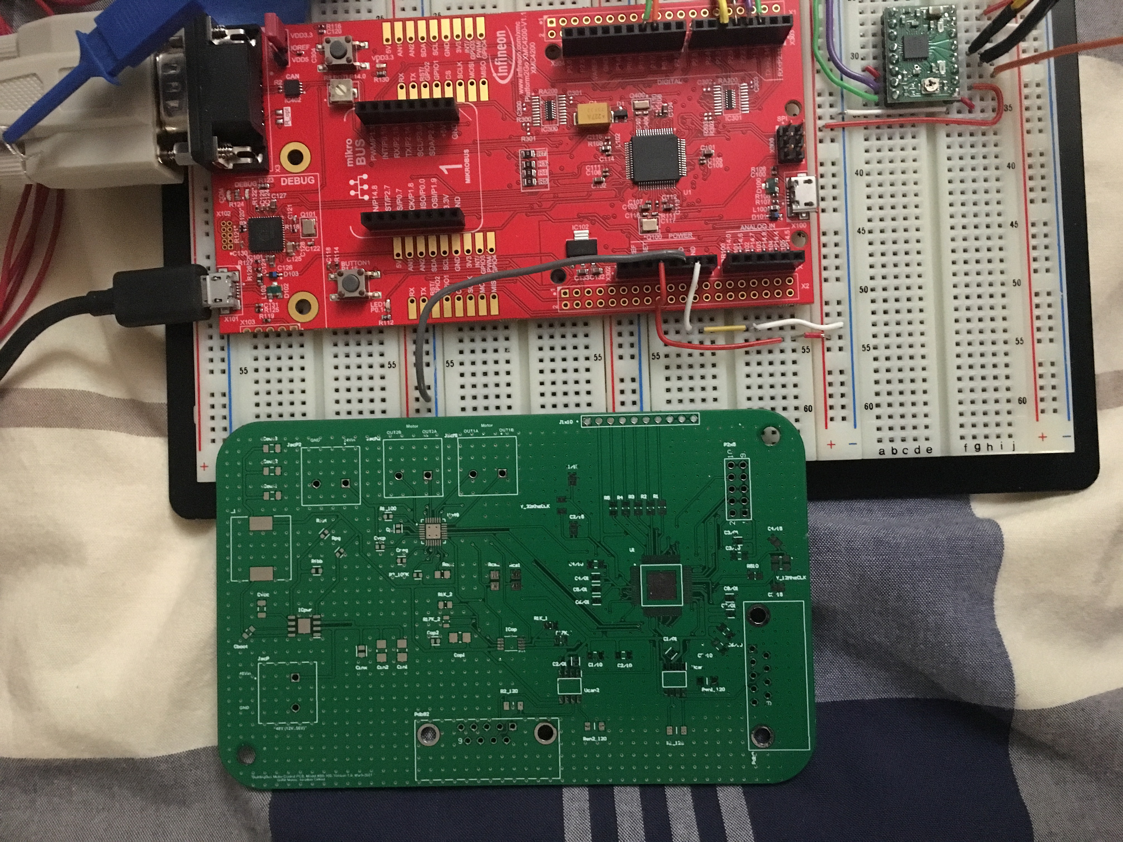
PCB Status & Overview
Notes:
Griff
Our PCB Compared to the Evaluation Board

Slide 17
FPR Plan
Full end to end connectivity
Fully assembled PCB
If the PCB is not working properly, then full documentation of the failure points and what can be done as an improvement will be provided.
Local connection backup software functionality
Quality of Life Features on the app
Includes images as opposed to current text output
Notes:
Frank

Slide 18
Hardware Plan For FPR
Fully assembled PCB for the Motor Module with all 70 Components
The Window will be fully functional
The Network Master Controller (NMC) board will remain as-is
Notes:
Frank

Slide 19
Hardware & Software Used
Software | Hardware
DAVE IDE DAVE APPs Android Studio AWS MQTT Library Amazon Web Services (AWS) IoT Core (Message Streams) Cognito Altium Texas Instruments WEBENCH | XMC-4800 Microcontroller XMC-4200 Microcontroller A4988 Motor Driver 24V DC Stepper Motor Power Supply CANBus Wire Window Hardware (wood, pulleys, switches, etc.)
Notes:
Frank

Slide 20






Project Management
Jonathan Clifford
Team Coordinator & AWS, Android Application Developer
Griffin Manns
Stepper Motor Module & Altium Lead
Professor Arman Pouraghily
Advisor
Frank Cremonini
CAN Bus Communication
Connor Moore
Network Master Controller & Budget
Mr. Glenn Weinreb
Manhattan2 CTO & Contact
Notes:
Griff

Slide 21
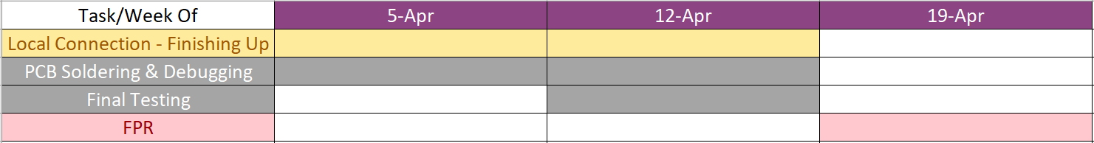
Gantt Chart - Spring 2021 - FPR
Notes:
Griff:
FPR:
My Responsibilities:
I will be installing Components & Debugging for the PCB
All:
Will be designing and updating the overall Window model and system and also confirming that end to end Communication is working on the PCB for
Each task should take from 2-4 weeks, leaving a free week before CDR week in case anything takes longer than expected

Slide 22
Project Expenditures
Current Expenses:
Estimated Future Expenses:
Part | Price
XMC4800 Eval Board | 95.93
XMC4200 Eval Board | 55.47
Stepper Motor | 50.00
24v Shield (motor driver) | 25.97
Motor Driver | 8.00
XMC4800 Processor | 23.65
XMC4200 Processor | 14.62
XMC 4000 debugger | 95.00
PCB components | 22.89
Custom board version 1 | 58.15
Custom board version 2 | 35.11
Mouser order for crystal oscillator | 14.79
DigiKey order (remaining pcb parts) | 49.37
TOTAL | $548.95
Part | Cost ($)
None | 0
Overall Expenses (Current + Future) | $548.95
Notes:
Griff:

Slide 23
Questions & Answers
Notes:
Griff
End

Slide 24

CDR Demo - Backup Video
Notes:
Backup video

